Slide 1





Musical micro:bit
Teacher lesson guide
Lesson 5

Slide 2
Learning objectives:
To modify programs to meet given criteria.
To decompose learning from the unit.
To evaluate the BBC micro:bit as a music-making device.

Slide 3
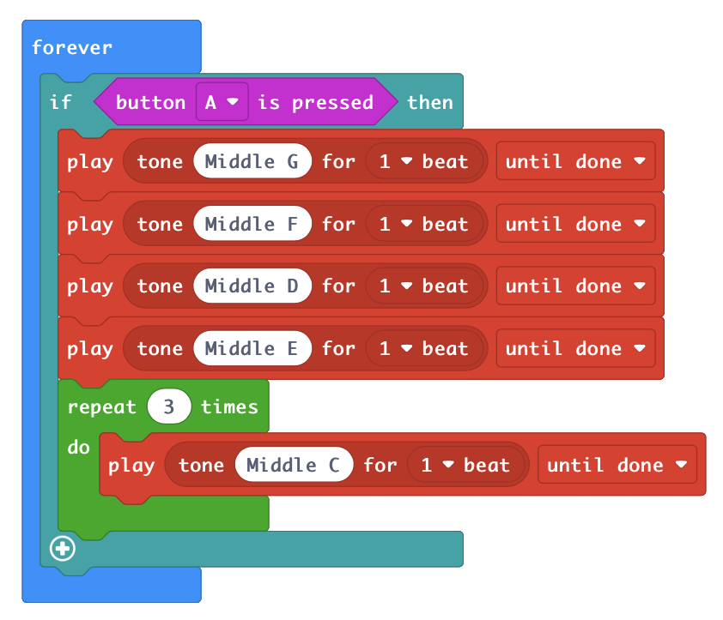
Programming challenges
Modify the program so it:
Starts with a different input
Starts on a different note
Plays middle C four times
Plays middle D three times
Repeats the musical phrase twice
https://makecode.microbit.org/_ce0XmW5FMD8g

Slide 4
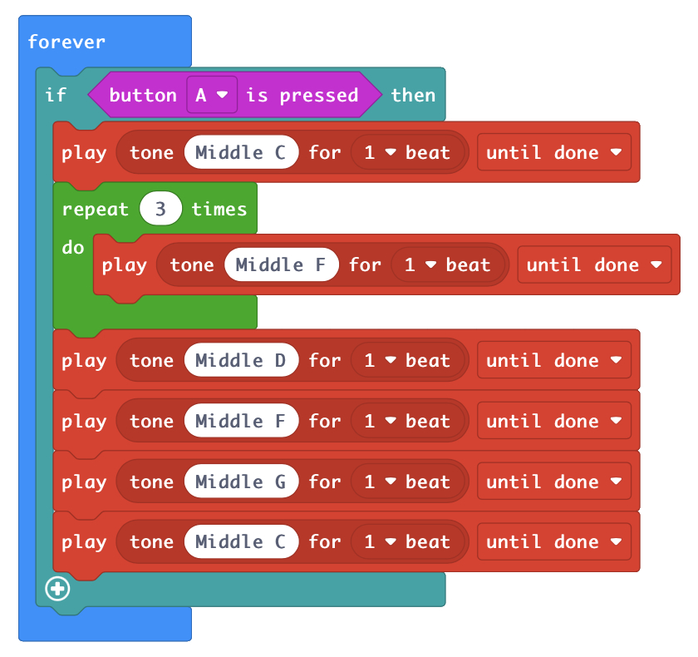
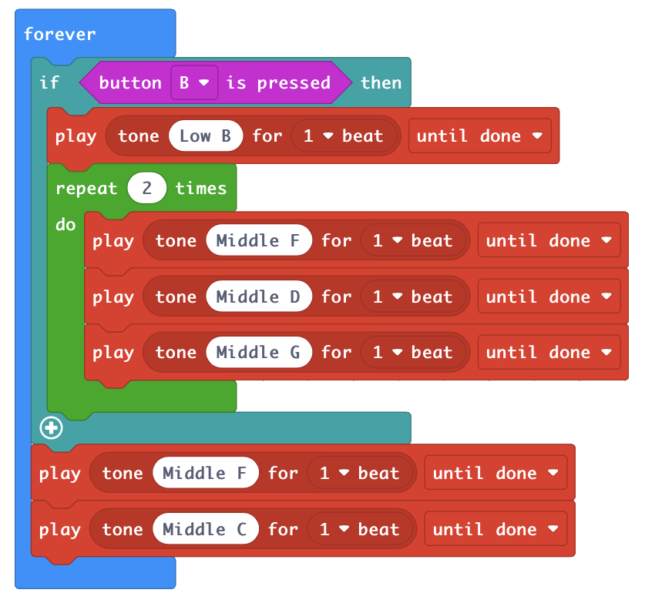
Creating programing challenges
Create challenges for your program.
The challenge should require someone to modify the program.
https://makecode.microbit.org/_J9bD1DbvFhJ9
https://makecode.microbit.org/_FW8DXzgrVAiP
https://makecode.microbit.org/_J9bD1DbvFhJ9
https://makecode.microbit.org/_FW8DXzgrVAiP

Slide 5
Completing programing challenges
Change the program so it meets the criteria set out in the other group’s challenges.
Record the changes you made to the program next to each challenge.
Modify the program so it: | How did you modify the program?
Repeats F five times Starts with a different input Contains an extra note Ends on a different note Repeats G twice | Changed the number in the repeat block from 3 to 5 Changed to ‘on button B pressed’ Added Low A after Middle F Changed Middle C to Middle E Placed a repeat block around Middle G

Slide 6
Playing musical instruments
People enjoy listening to music being played on instruments.
Some people are restricted from playing musical instruments.
Can you think of reasons why a person might not be able to play a musical instrument?

Slide 7
The micro:bit as a music-making device
Could a micro:bit offer a way of making music to someone who is restricted from playing a musical instrument?
How might a person use it?
What would the person need to learn before they could use it?

Slide 8
Decomposition
What does the term decomposition mean?
Programing a micro:bit as a music-making device: decompose all the things we have had to learn to be able to do this.
Notes:
Decomposition is the process by which a more complex problem is broken down into smaller problems and by solving these smaller problems the bigger problem is solved.
The unit can be decomposed into programing micro:bit to play musical phrases, connecting micro:bit to headphones/speakers, programing micro:bit to play notes when certain inputs are used.

Slide 9
A guide to making music with the micro:bit
Create two slides for a presentation on how to make music with a micro:bit.
One slide shows how to program your micro:bit to play musical phrases.
The other shows how to use some of the inputs on a micro:bit to play the notes in an octave.
Each slide should contain:
a snapshot of your program
a brief explanation of your program
challenges for someone to complete

Slide 10
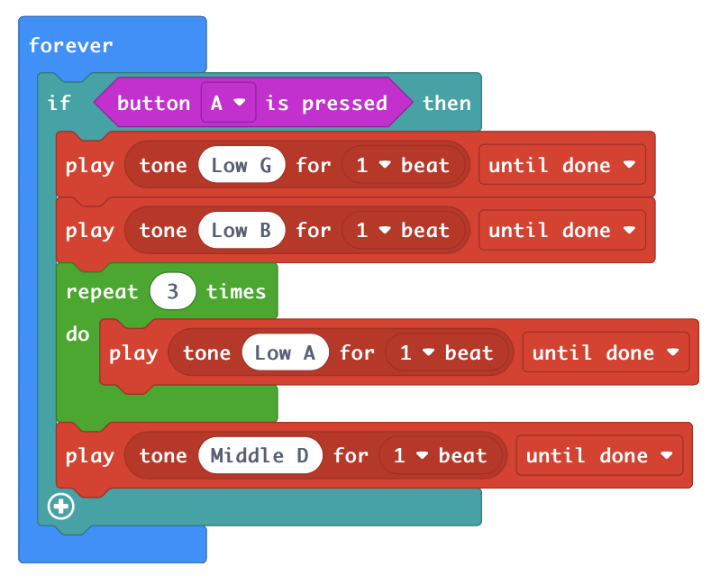
Example slide -
programing a musical phrase
When button A is pressed the notes G, B, A, A, A, and D will be played.
Forever is used so the micro:bit is always checking if button A has been pressed.
Repetition is used to tell the micro:bit to play note Low A three times.
Challenges:
change one of the notes in the musical phrase
add another note to the musical phrase
change the number of times that note A is played
place another note within the repeat loop

Slide 11
Evaluating musical micro:bit
 | Programming a micro:bit to play musical phrases | Programing a micro:bit to use inputs to play notes
advantages
disadvantages
Notes:
An example of the types of comment children might give is given on slide 10.

Slide 12
Learning objectives revisited:
To modify programs to meet given criteria.
To decompose learning from the unit.
To evaluate the micro:bit as a music-making device.

Slide 13
Evaluating musical micro:bit
 | Programming a micro:bit to play musical phrases | Programing a micro:bit to use inputs to play notes
advantages | Do not need to know how to play an instrument. Do not need to be able to read music. | Quick to learn how to make the different notes. Easier to move the micro:bit than to play an instrument.
disadvantages | Can only make one style of sound. Need access to the internet to write the program.

Slide 14
Modify the program so it: | How did you modify the program?
Repeats F five times Starts with a different input Contains an extra note Ends on a different note Repeats G twice | Changed the number in the repeat block from 3 to 5 Changed to ‘on button B pressed’ Added Low A after Middle F Changed Middle C to Middle E Placed a repeat block around Middle G

